Slide 1


Predicting Phillies Money Lines
B.G. Lemmon
The Flatiron School
August 1, 2019

Slide 2
Process / Goal of Project
Scrape all relevant data
Create model to predict outcome of games
Use probability to determine chances of each outcome
Create money lines from probabilities for final product

Slide 3
Step 1: Scraping the Web
Scraped data for all 30 teams and each of their 162 game results since 2015
    Collected 26 features for each team per game (8 pitching, 17 Hitting, and the outcome)
      Most important predictor: Opponent Batting Average
Created a data frame with Phillies schedule for each season
Combined all of them for one data frame

Slide 4
Step 2: Create Models
Logistic Regression
  Ideal as to predict whether the Phillies opponent would win (1) or lose (0)
  Testing Accuracy: 62.7%
XGBoost
  Gradient boosted decision tree with optimal speed and performance
  Testing Accuracy: 65.4%

Slide 5
XGBoost Explained
Hyperparameters were constantly adjusted to find optimal model
    Max_depth – maximum depth of trees
      Had to keep it to 1 (normally 6) because cause overfitting
    Min_child_weight – sum of weights of all observations
      Higher the number, prevents a model from learning relations (prevents overfitting)
      Default is 1, optimal model was set to 4

Slide 6
Training/Adjusting Data
Several points were adjusted to try and find the optimal model:
    How many games did the model have to go back for both Phillies and opponent to be trained on
        Optimal was around 15
    How many games did the input for the model have to go back and keep track of for best results
        Optimal was around 4
    Dummy Variables for Home/Away and Opponent
        Created too many features and overfit my model, so removed them

Slide 7
Step 3: Find Probability
Predict_proba
  Gives you the probabilities of the target occurring
    “0” for Phillies Win
    “1” for Phillies Loss
After running through XGBoost, used function to give me probability of each event occurring

Slide 8
Step 4: Calculate $$ Lines
From my earlier blog this year, we learned the following, given money line, ML:
Favorites: ML / (ML – 100) = Win Probability
Underdog: 100 / (ML + 100) = Win Probability

Slide 9
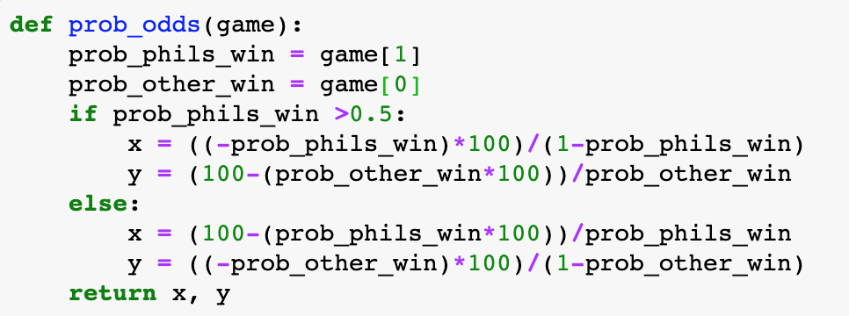
Calculate $$ Lines (cont.)
Here is the function used to calculate money lines:

Slide 10
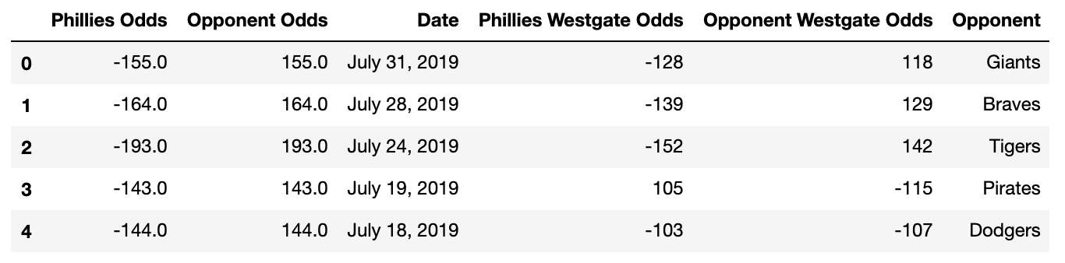
Final Results
First 3 Series are within a $41 error (before adjustment)
Last 2 Series fail to predict Phillies as underdog

Slide 11
Takeaways & Future Goals
Too many features cause overfitting with XGBoost
Need to be more organized with my approach / Jupyter Notebooks
Need to utilize GridSearch
Want to run lines for ALL teams
Create a final interactive website for all users

